Slide 1
Capstone III Insurance Dataset:
Stephanie Kirk
Data Analytics Capstone III | Thinkful

Slide 2
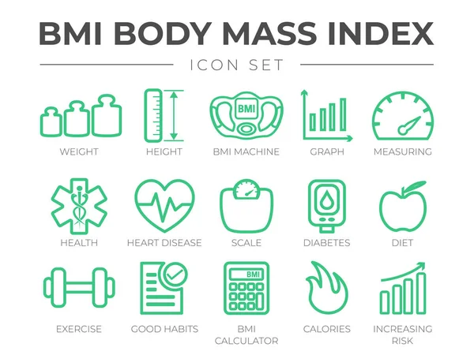
Objective
Identify potential factors in determining BMI.
Provide recommendations on how potential risk factors can be used to drive business objectives.
Notes:
The people that may find these findings valuable are insurance companies, employers, and health organizations like the CDC.
This is important because a high BMI has been proven to be a high-cost health factor for customers, insurance companies, employers.
By identifying potential determinants for higher BMI this could allow employers to target workplace health programs more affectively to improve employee health and decrease their health care expenditures. Insurance companies could find this helpful in calculating premiums for higher risk customers. The CDC could find this information helpful in identifying potential public health issues and how they are affecting citizens.

Slide 3
The Data
The data consisted of a sample size of 1338 health insurance customers information.
The data set is made up of 7 columns of the primary beneficiary's health related information.
The data used in my analysis was pulled from Kaggle: https://www.kaggle.com/mirichoi0218/insurance
RangeIndex: 1338 entries, 0 to 1337
Data columns (total 7 columns):
# Column Non-Null Count Dtype
--- ------ -------------- -----
0 age 1338 non-null int64
1 sex 1338 non-null object
2 bmi 1338 non-null float64
3 children 1338 non-null int64
4 smoker 1338 non-null object
5 region 1338 non-null object
6 charges 1338 non-null float64
dtypes: float64(2), int64(2), object(3)
*DataFrame information for Insurance Dataset

Slide 4
Methods
Imported csv file from Kaggle into Pandas Dataframe in Google Colab.
Performed shape(), info(), and head() methods to get an idea of the dataset.
Split variables into groups using Dataframe manipulation.
Conducted the following Statistical tests:
Correlation analysis using .corr() method
Calculated confidence intervals
Two-sample t-test using stats.ttest() method
Notes:
The .info() method contains the number of columns, column labels, column data types, memory usage, range index, and the number of cells in each column (non-null values). The .shape() shows the current shape of an array. .head() give the first 5 rows of the Dataframe.
Correlation method gives a value called correlation coefficient. A correlation expresses the strength of linkage or co-occurrence between to variables in a single value between -1 and +1.
The t-test will compare the means of these two samples and give a value that indicates how different these two means are. It will also give a p-value indicating how likely it is that this difference is due to random chance. A low p-value means that it is unlikely to occur by random chance, meaning that you have a significant result.
Using the confidence interval, I can quantify the difference between the average BMI of two groups. The confidence interval gives me the probability that the parameter will fall between an upper and lower value around the mean. This helps me to determine the level of impact.

Slide 5
My Hypotheses
Hypothesis 1: The null hypothesis is that there is no significant difference in BMI between beneficiaries that are older or younger than 40 years old.
Hypothesis 2: The null hypothesis is that there is no significant difference in BMI between the northern and southern regions of the beneficiary’s residences.

Slide 6
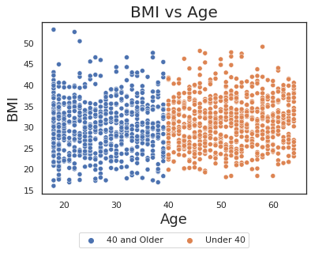
Age
Succeed in rejecting the null with 95% confidence and p-value of <.000367.
Correlation Statistic: 0.097257
Older than 40 average BMI 31.2607
Younger than 40 average BMI 30.0749
With 95% confidence, customers older than 40 years old have between 0.535 and 1.836 higher BMI than those who are younger than 40 years old.

Slide 7
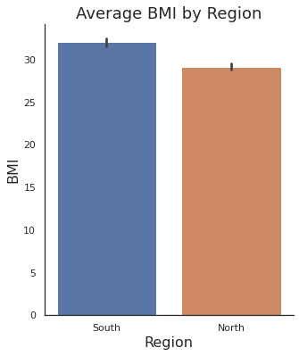
Region
32.054
29.187
Succeed in rejecting the null hypothesis with 95% confidence and p-value of 2.91999e-18.
Correlation Statistic: 0.235
With 95% confidence, customers from the south have on average between 2.234 and 3.501 higher BMI than customers in the north.
Notes:
This means we succeed in rejecting the null hypothesis with 95% confidence that there is no difference in BMI between the northern and southern regions of the beneficiary’s residences. What this means in that it is unlikely that the difference in the means is due to random chance.

Slide 8
Recommendations
Age (over 39 vs under 40 years old):
Extremely low correlation
Small mean difference
Similar means above BMI of 30.0
Region (North vs South):
Low p-value
Average BMI of above 30.0 in the South
Confidence interval of between 2.2 and 3.5
Notes:
Age: Based on my findings it is clear that being older or younger than 40 years old is not a factor that should be used to determine BMI.
The actual observed difference between the two age categories is so small that it has no real world-significance.
Region: Based on my findings I would recommend that Region be used as a risk factor for determining BMI due to the difference in BMI category.
This can be used by employers with workers located nationally to target their employee health programs more affectively by understanding that employees located in the south should have health plans targeted differently than those in the north. For example, they could target nutritional and physical exercise plans to southern employees more than northern employees due to the higher BMI observed in the south. This will allow them to improve employee health and decrease their health care expenditures.

Slide 9

Next Steps
I’d like to dive into more variables such as
Charges
Number of Children
Datasets with additional information
Datasets with additional information
Insurance type
Education
Existing long-term illness
Occupation
Notes:
Next steps in order to expand me work:
The healthcare industry is a large complex machine with
I think it would be interesting to quantify exactly how much more expensive someone’s health costs are based on region or BMI. I also think it could be interesting to see how the number of children someone has can affect their health as well.
I would also like to find and utilize other datasets that have additional variables so I can look at more than just the 7 variables I have currently. For example, health insurance type, existing long-term illnesses, education, and occupation would all be variables that would be interesting to test for effect on costs as well.

Slide 10

Questions
Contact:
sakirk@csbsju.edu

